Slide 1
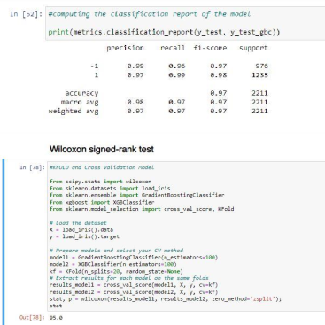
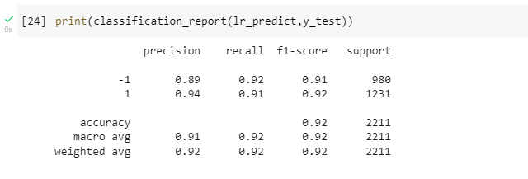
Project Development Phase Model Performance Test
Date | 13 November 2022
Team ID | PNT2022TMID50730
Project Name | Web Phishing Detection
Maximum Marks | 10 Marks
Model Performance Testing:
Project team shall fill the following information in model performance testing template.
S.No. | Parameter | Values | Screenshot
1. | Metrics | Classification Model: Logistic Regression Accuray Score- 91.6%
2. | Tune the Model | Hyperparameter Tuning - 97% Validation Method – KFOLD & Cross Validation Method
1. METRICS: CLASSIFICATION REPORT:

Slide 2
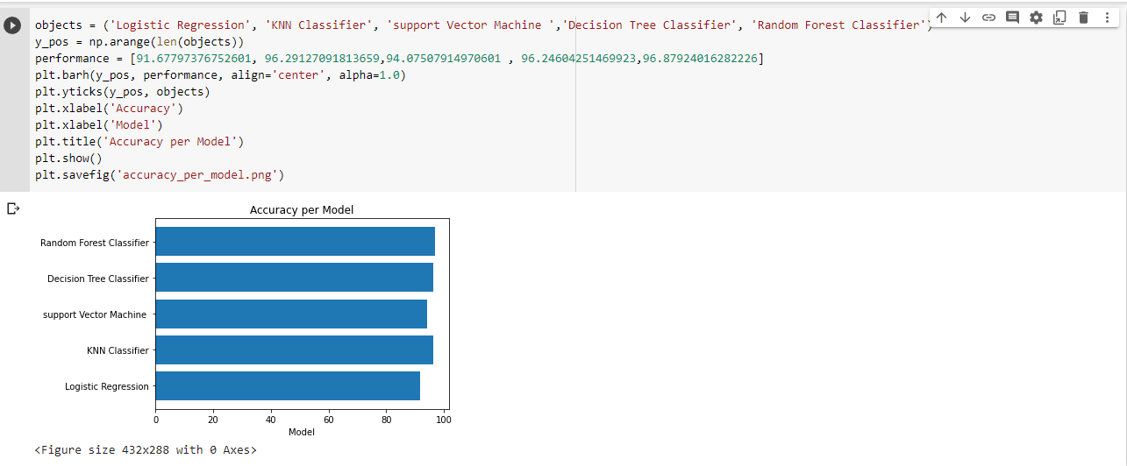
PERFORMANCE :

Slide 3
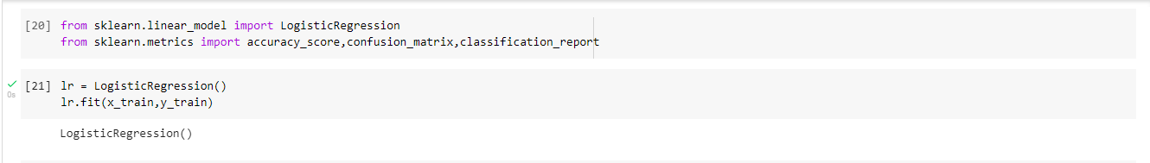
2. TUNE THE MODEL – HYPERPARAMETER TUNING

Slide 4
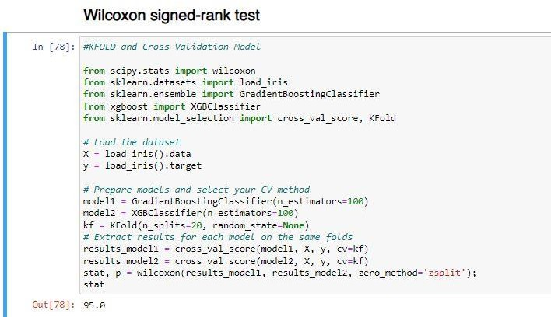
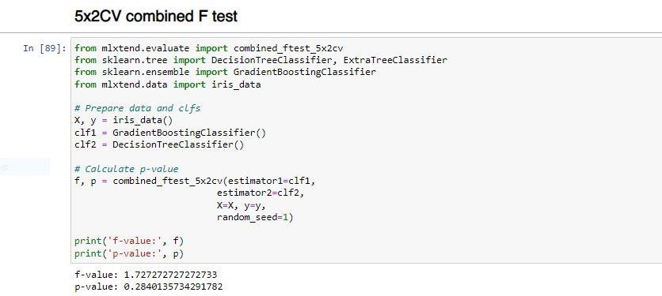
VALIDATION METHODS: KFOLD & Cross Folding

